Slide 1


E-PROJECT 2021
EXPLORING IDEAS FOR TOMORROW

Slide 2

GROUP MEMEBERS:
SYEDA FAZILA WALI :
Syeda Fazila Wali is completing her bachelor’s degree in software engineering from Virtual University-Karachi and also is enrolled in Aptech’s 3 year Software Program.
SUMNA IMRAN:
Sumna Imran is completing her bachelor’s degree in computer science from UBIT-Karachi University and also is enrolled in Aptech’s 3 year Software Program.

Slide 3

INSTRUCTOR:
MOHAMMAD FAIZAN:
Graduated from Karachi University, 3 years Diploma from Aptech, MCS from Microsoft.

Slide 4
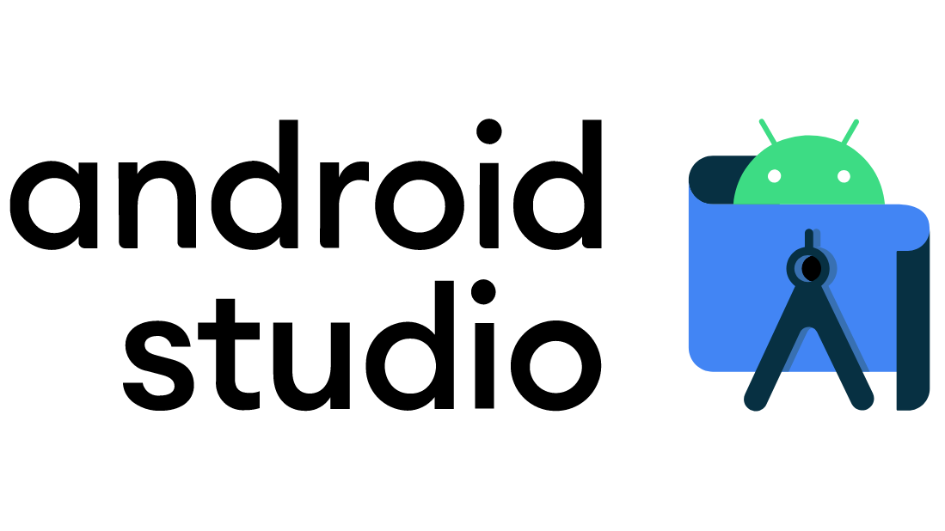
TECHNOLOGY USED:
ANDROID STUDIO:
Android Studio is the official Integrated Development Environment (IDE) for Android app development, based on IntelliJ IDEA . On top of IntelliJ's powerful code editor and developer tools, Android Studio offers even more features that enhance your productivity when building Android apps, such as:
A flexible Gradle-based build system
A fast and feature-rich emulator
A unified environment where you can develop for all Android devices
Apply Changes to push code and resource changes to your running app without restarting your app
Code templates and GitHub integration to help you build common app features and import sample code
Extensive testing tools and frameworks
Lint tools to catch performance, usability, version compatibility, and other problems
C++ and NDK support
Built-in support for Google Cloud Platform, making it easy to integrate Google Cloud Messaging and App Engine

Slide 5

OUR PROJECT FOR E-Project 2021: “FSEATS”

Slide 6
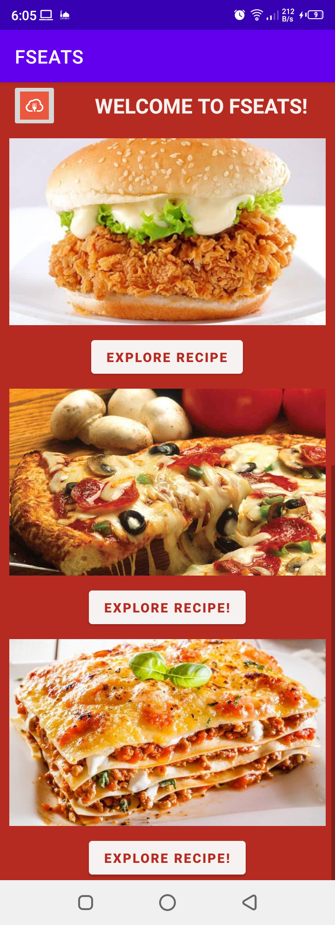
HOME PAGE

Slide 7
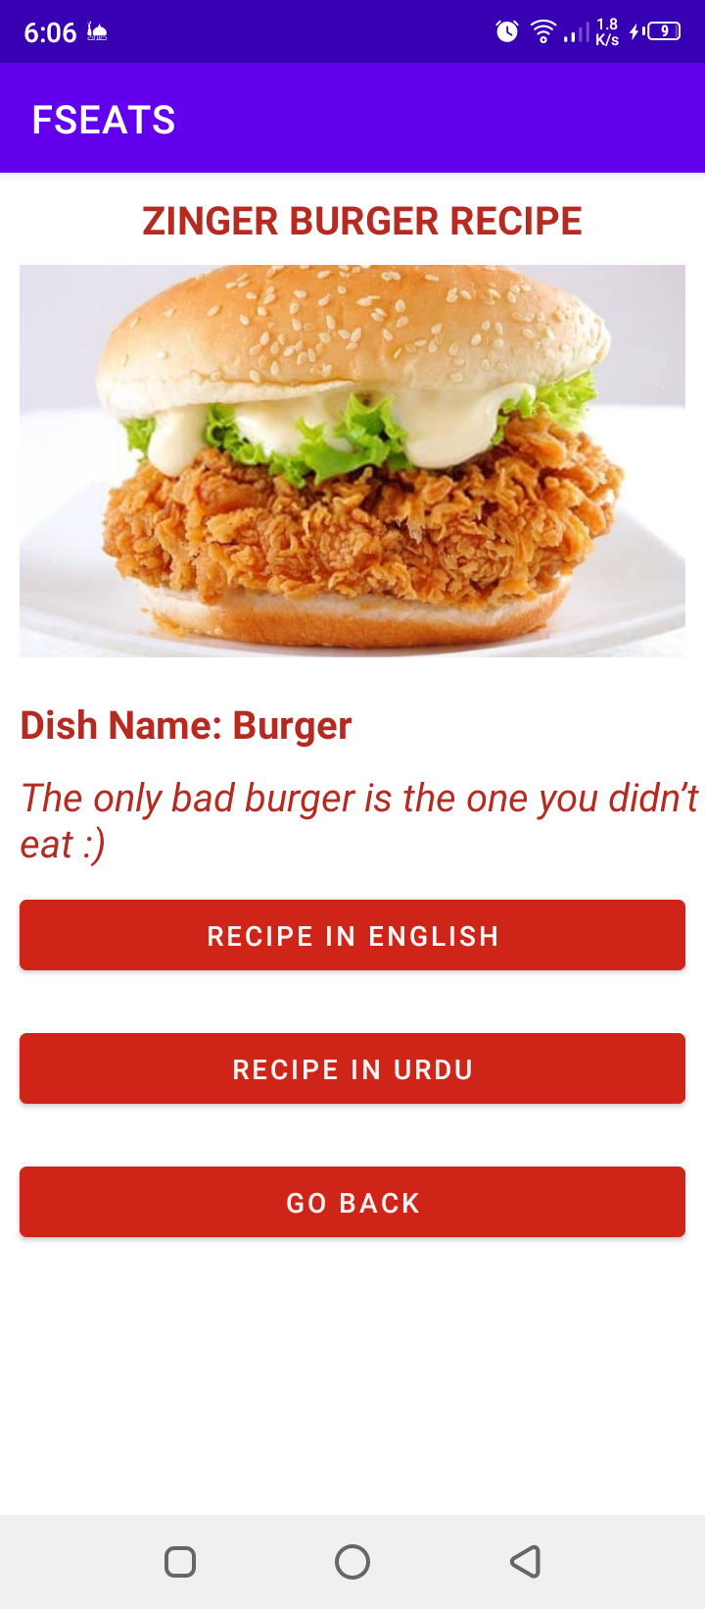
BURGER’S RECIPE PAGE

Slide 8
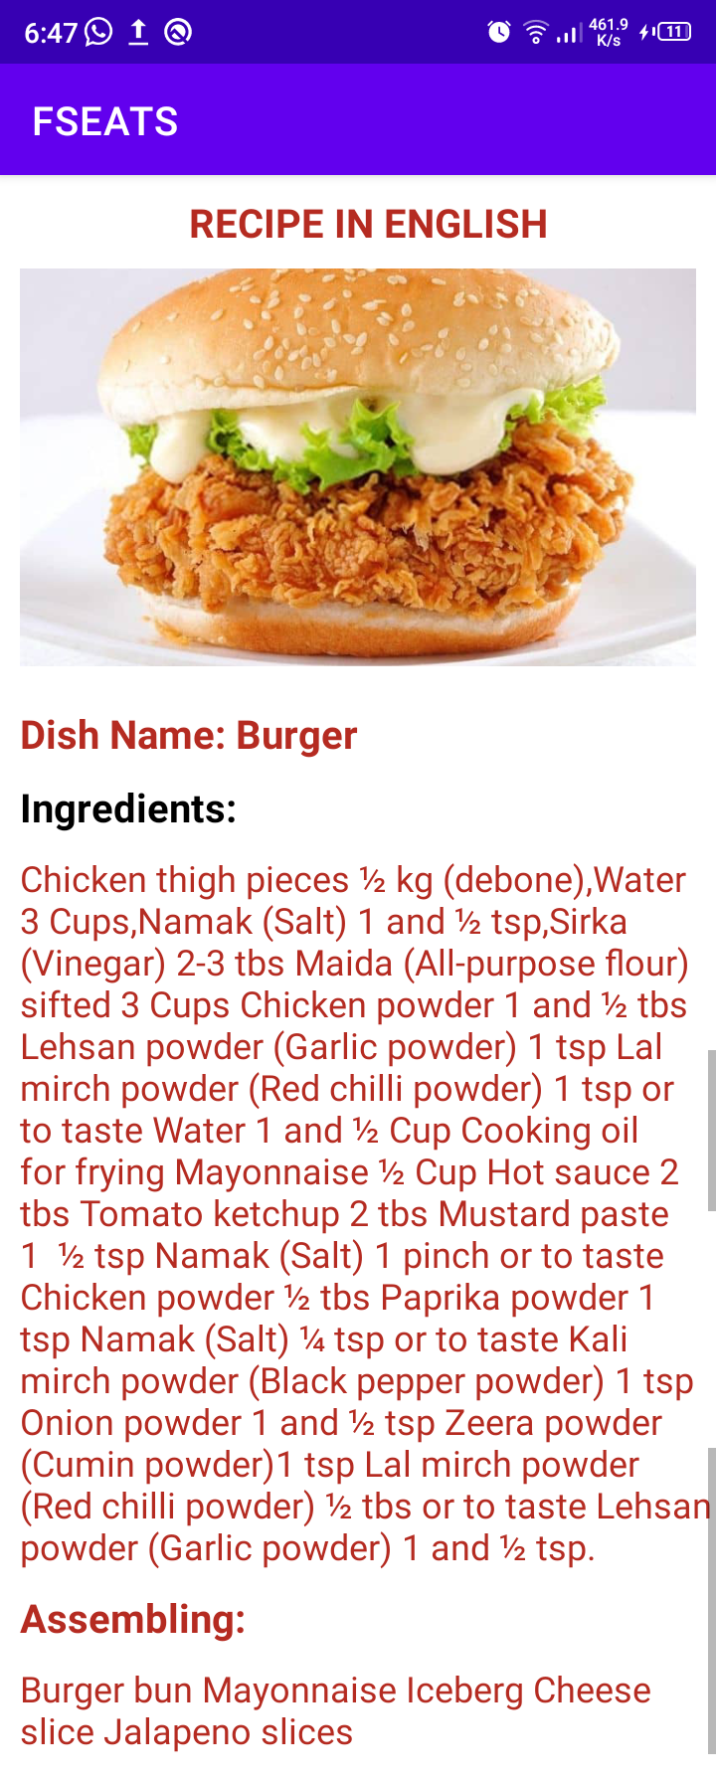
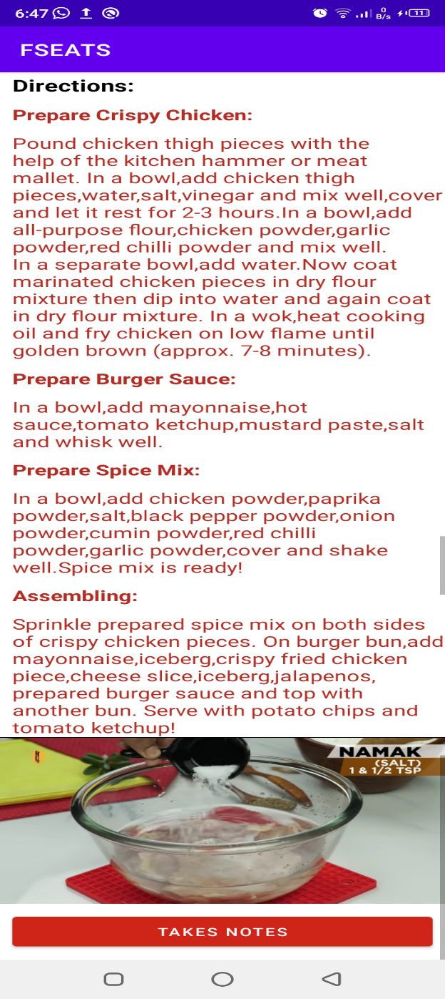
BURGER’S RECIPE IN ENGLISH

Slide 9
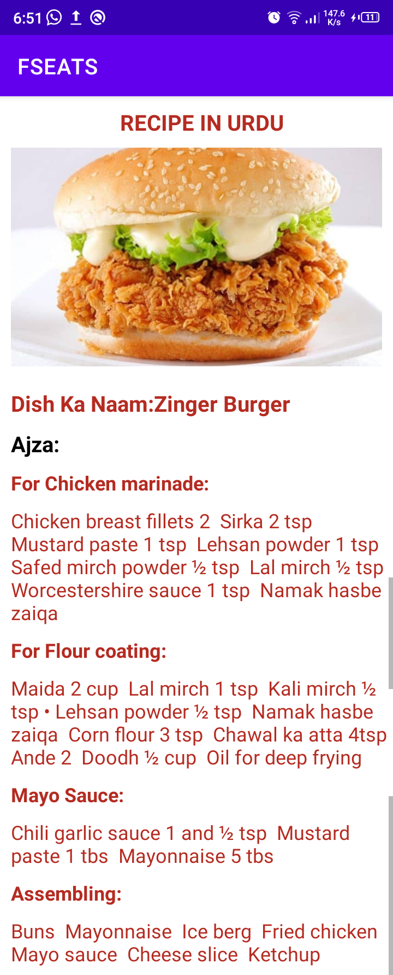
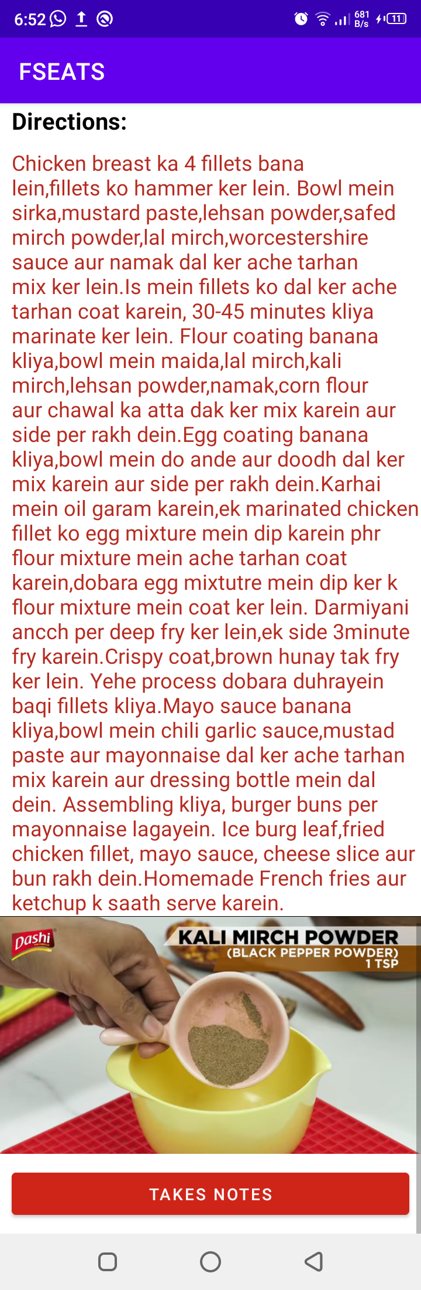
RECIPE IN URDU

Slide 10
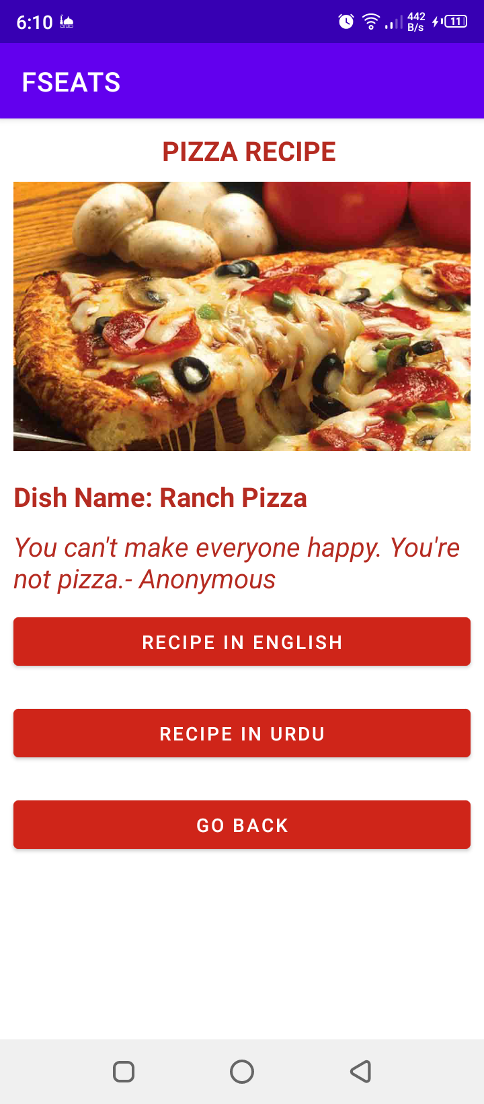
PIZZA RECIPE PAGE

Slide 11
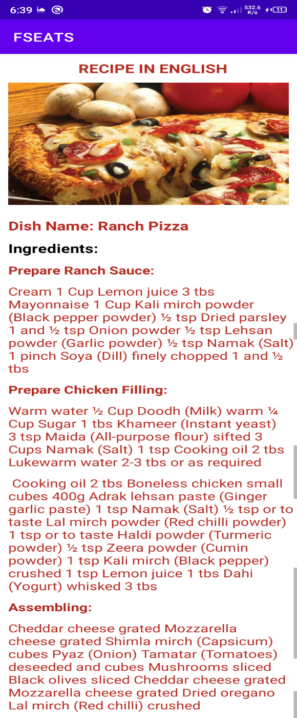
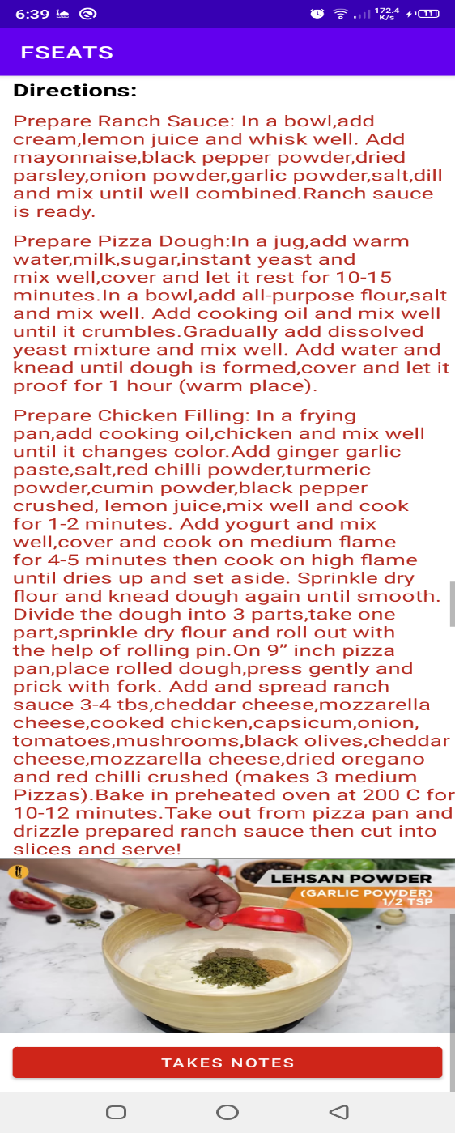
PIZZA’S RECIPE IN ENGLISH

Slide 12
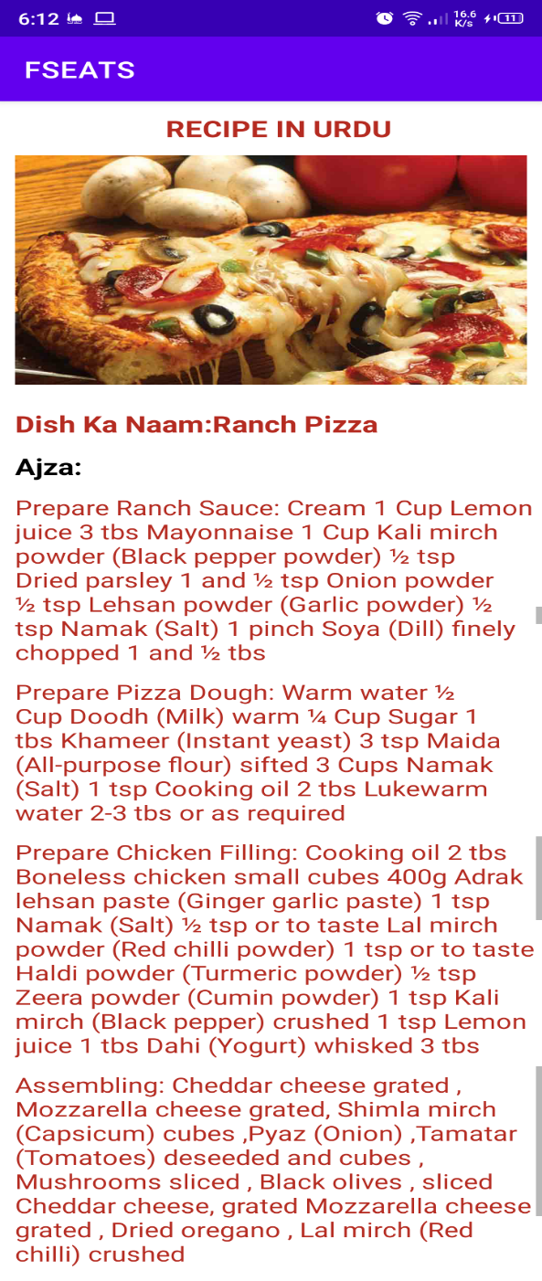
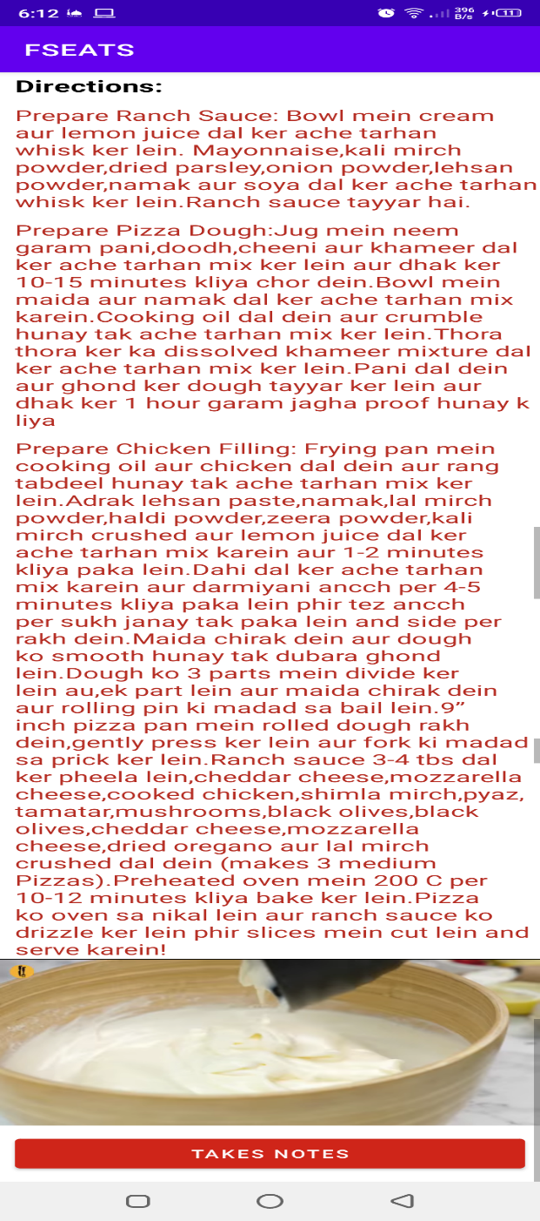
PIZZA’S RECIPE IN URDU

Slide 13
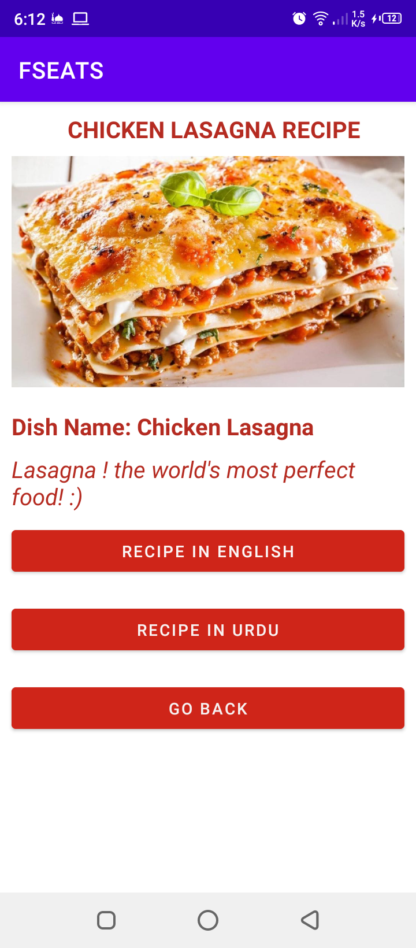
LASAGNA’S RECIPE PAGE

Slide 14
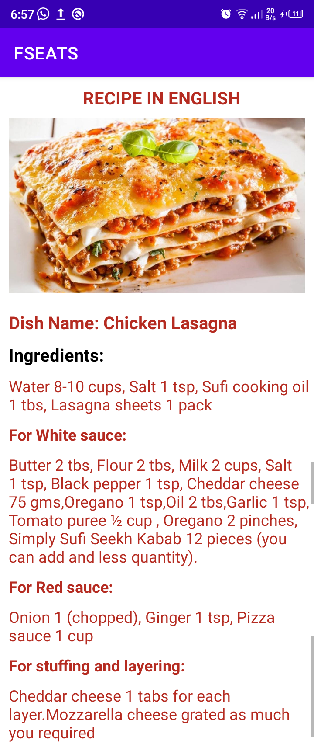
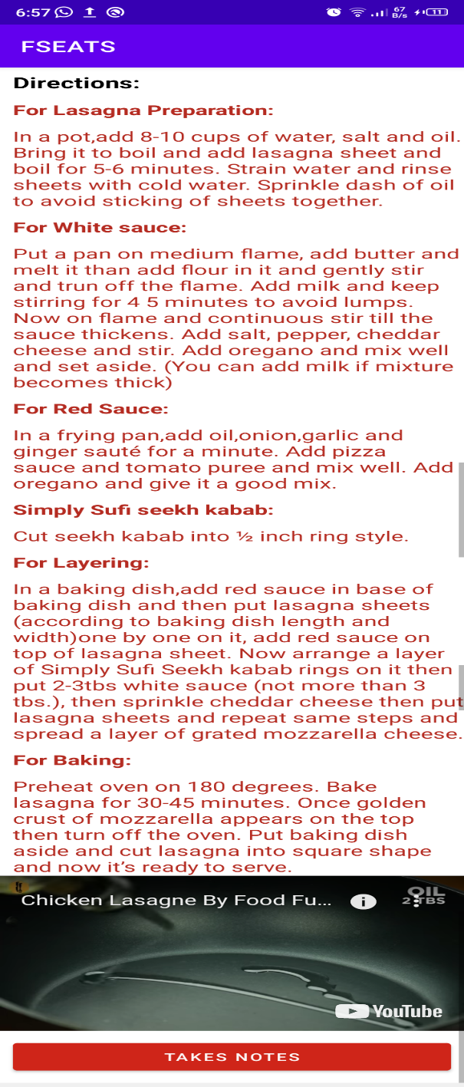
LASAGNA’S RECIPE IN ENGLISH

Slide 15
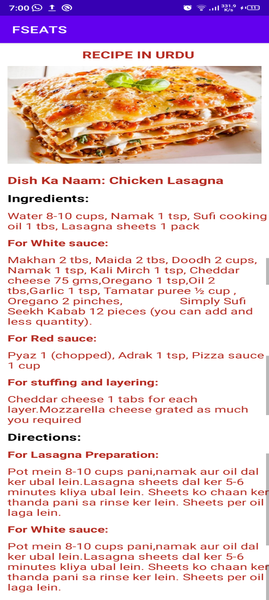
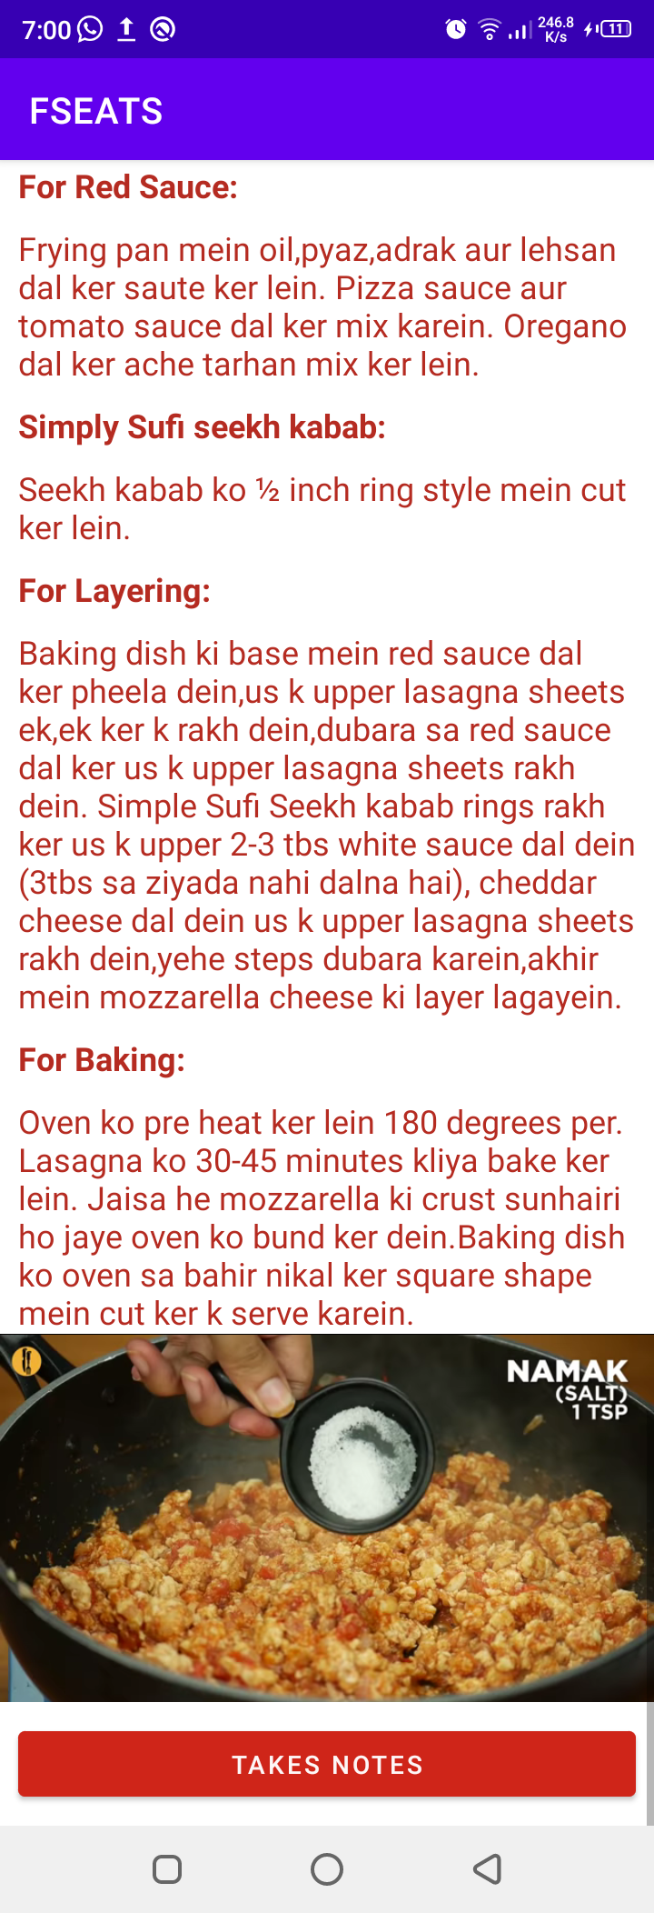
LASAGNA’S RECIPE IN URDU

Slide 16
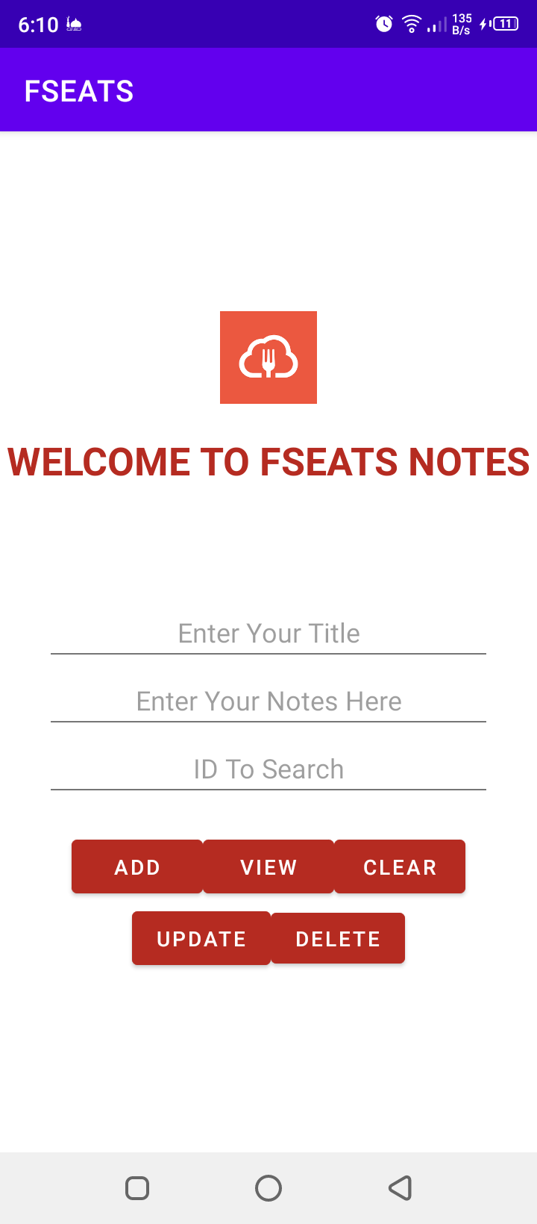
FSEATS NOTES

Slide 17
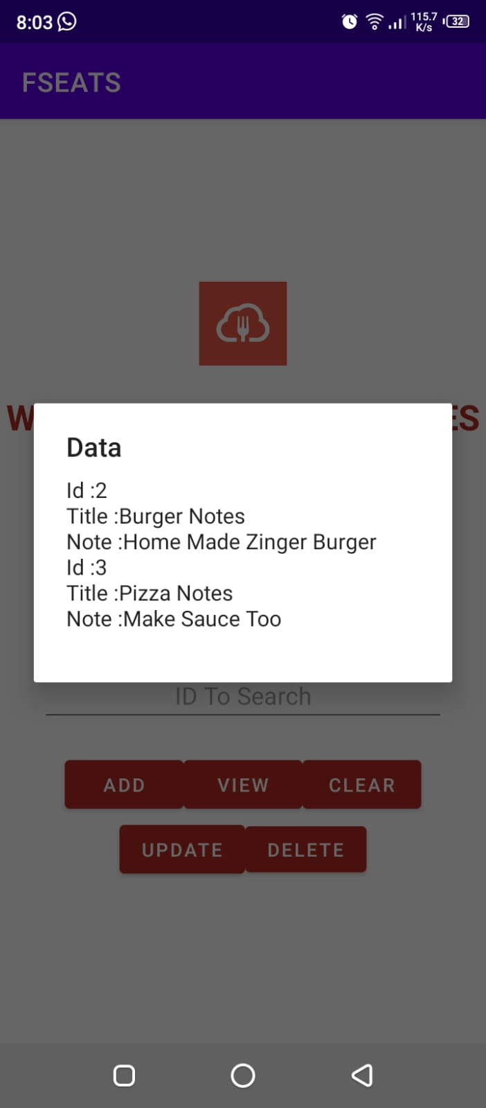
FSEATS NOTES INSERTED

Slide 18
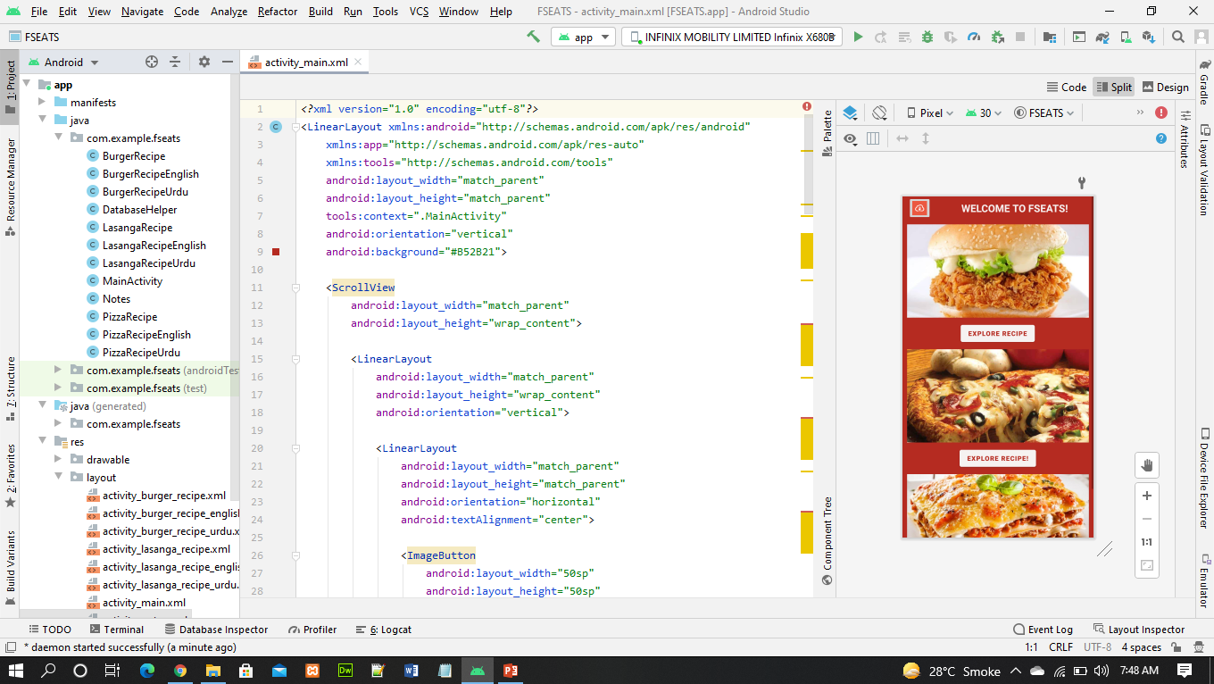
BACKEND VIEW

Slide 19
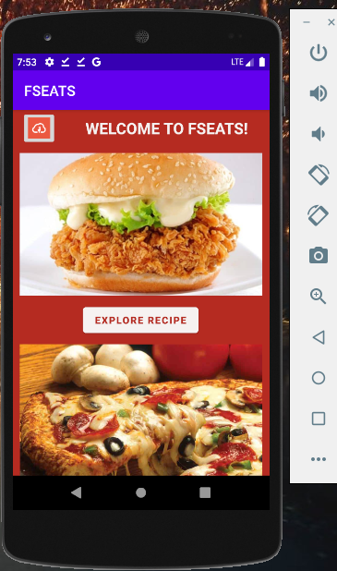
APP RUN ON EMULATOR

Slide 20

THE END
THANK YOU FOR YOUR ATTENTION!

